Slide 1

CS8811- PROJECT WORK FPS SURVIVAL GAME USING UNITY
Batch No : C19
Project Co-Ordinator : Dr. N. Pughazendhi, M.E., Ph.D.
Project Guide : Dr. S. Hariharan, M.E., Ph.D.
Team Members:
1.Sujith Kumar S (211418104272)
2.Vaidhyanathan S (211418104299)
3.Vignesh V (211418104309)

Slide 2
INTRODUCTION
Games are not just a computer software that are made to benefit users daily life, rather it is made for users entertainment purpose, so we need to pay attention to what the user wants from the game, how to make it more entertaining, just making any game will not do, that is why making games are more challenging.
we are developing FPS Survival game i.e. First-person shooter, it is a video game genre centred around gun and other weapon-based combat in a first-person that requires players to master the skills necessary to operate several types of guns and other weapons that are typically used in eliminating enemy. This game also comes under the role playing category too

Slide 3
LITERATURE SURVEY
S.NO | DESCRIPTION
1 | TITLE NAME: Rapid Skill Capture in a First-Person Shooter. AUTHOR NAME: David Buckley, Ke Chen, Joshwa Knowles. YEAR: 2017
2 | TITLE NAME: Applying inexpensive AI techniques to computer games AUTHOR NAME: A. Khoo, R. Zubek YEAR: 2002
3 | TITLE NAME: Learning to win in a first-person shooter game. AUTHOR NAME: Chishyan Liaw, Wei-Hua Andrew Wang, Chung-Chi & Yu- Liang Hsu. YEAR: 2013
4 | TITLE NAME: Using Games to Study Law of Motions in Mind AUTHOR NAME: Hiroyuki lida, Mohd Nor Akmal Khalid. YEAR: 2020

Slide 4
S.NO | DESCRIPTION
5 | TITLE NAME: Using Games to Study Law of Motions in Mind AUTHOR NAME: Hiroyuki lida, Mohd Nor Akmal Khalid. YEAR: 2020
6 | TITLE NAME: Challenges and Opportunities in Game Artificial Intelligence Education Using Angry Birds. AUTHOR NAME: Du-Mim Yoon, Kyung-joong Kim. YEAR: 2015
7 | TITLE NAME: Optimizing Player and Viewer Amusement in Suspense Video Games. AUTHOR NAME: Pablo Delatorre, Carlos Leon, Alberto Salguero Hidalgo, Alan Tapscott. YEAR: 2019
8 | TITLE NAME: Lag Compensation for First-Person Shooter Games in Cloud Gaming. AUTHOR NAME: Zhi Li, Hugh Melvin, Rasa Bruzgience, Peter Pocta, Lea Skorin-Kapov, Andrej Zgank. YEAR: 2018

Slide 5
OBJECTIVE
This game involves a single player entering a horror environment. Initially the player must find a weapon and need to equip it from the inventory menu. The environment is inhabited by creatures (i.e., enemies) that will attack the player if he goes into the area that the creatures inhabiting. Since the environment is dark the player can use flashlight and night vision to see the enemies. He must find and equip the batteries for the reuse of flashlight and night vision. The player must find and equip the bottle for health. If the player successfully kills the creatures the player moves to the upcoming enemies and environment and finally, he must find the keys to complete the game. The player can exit the game by pressing escape key or quit button in the menu option.

Slide 6
DEVELOPMENT ENVIRONMENT
Unity is a cross-platform game engine developed by Unity Technologies, first announced, and released in June 2005 at Apple Inc.'s Worldwide Developers Conference as a Mac OS X-exclusive game engine. It is considered easy to use for beginner developers and is popular for indie game development. The engine can be used to create three-dimensional (3D) and two-dimensional (2D) games, as well as interactive simulations and other experiences.

Slide 7
For Development of FPS Survival Game
Hardware Requirements
Processor: I5 6th Generation
RAM: 8 GB
Hard Disk: 1 TB
Graphics Card: NVIDIA GeForce GT 730
Software Requirements
Unity 2020.3.30f1 (64-bit)
Unity Hub
Adobe Photoshop
Visual Studio Code
C#

Slide 8
For Running FPS Survival Game
Desktop
Operating system : Windows 7 (SP1+), Windows 10
CPU : SSE2 instruction set support.
GPU : Graphics card with DX10 (Shader model 4.0) capabilities.
WebGL
Any recent desktop version of Firefox, Chrome, Edge or Safari.
Universal Windows Platform
Windows 10 and a graphics card with DX10 (shader model 4.0) capabilities

Slide 9
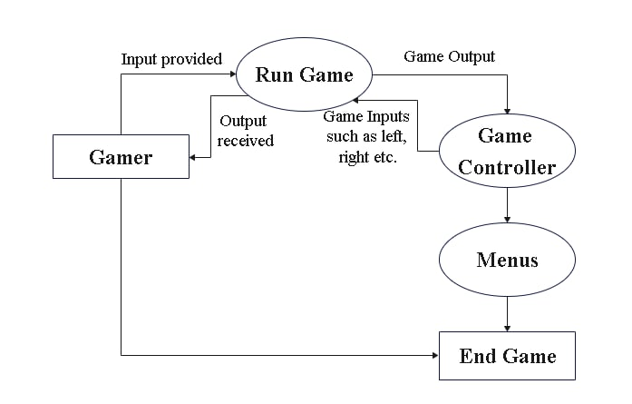
SYSTEM ARCHITECTURE

Slide 10
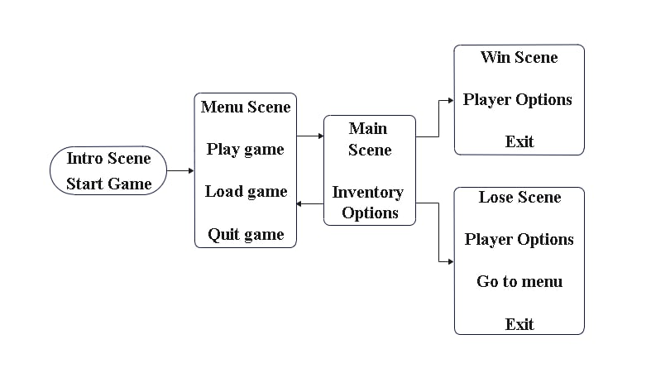
SYSTEM DESIGN DATA FLOW DIAGRAM

Slide 11
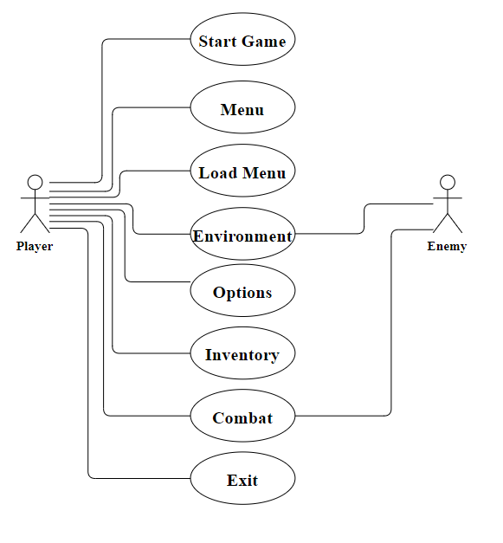
USE CASE DIAGRAM

Slide 12
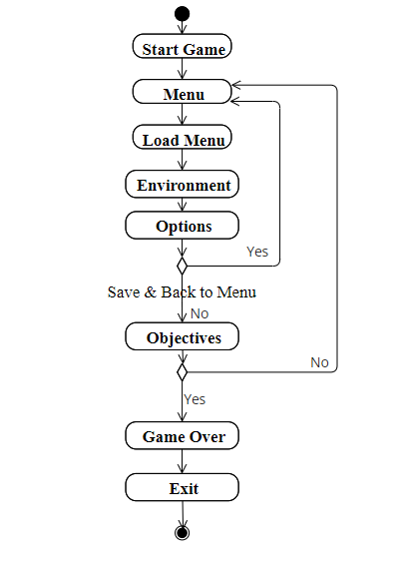
ACTIVITY DIAGRAM

Slide 13
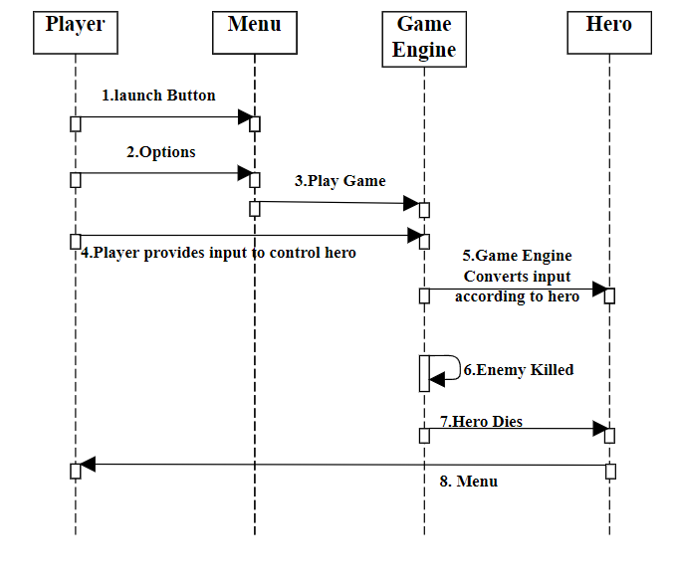
SEQUENCE DIAGRAM

Slide 14
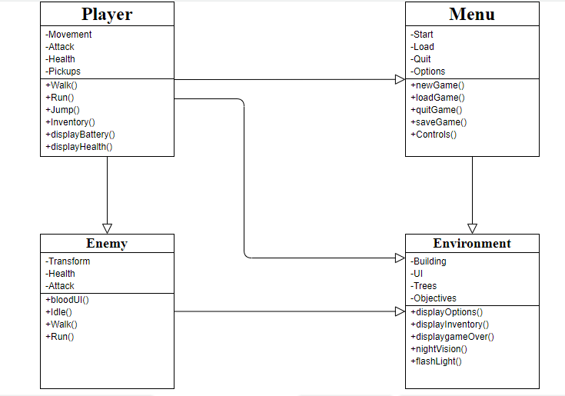
CLASS DIAGRAM

Slide 15
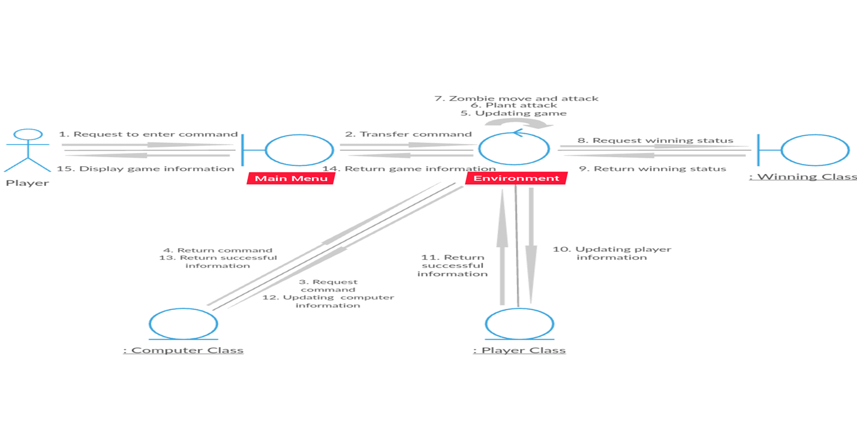
COLLABORATION DIAGRAM

Slide 16
MODULE DESCRIPTION
UI
In the opening screen, the UI will show VVS Creations and then the main menu will appear. The player can start playing the game by clicking the start button. In the main screen the player can load the saved game or can start a new game. The character of the person in the game will be seen in FPP mode where the user can only see the weapon in the hands of the character. The FPS character can move by clicking the arrow keys or can use the ‘ASWD’ keys and can jump using the space bar.
Pickups
The player can pick up objects like ammo, battery, etc. by going next to it and pressing ‘E’, can use flashlight using ‘F’ key and can use night vision glasses using ‘N’ key.

Slide 17
Environment
The environment is an island which consists of buildings, bridges, vehicles, river, and lakes.
Inventory
The player can open this inventory menu by pressing the key ‘I’. The objects which we have picked up from the game scenario will be shown in this Inventory menu i.e., Keys, Weapons, Health, Ammo, Objective, and Batteries. The player can equip any of those items from this inventory menu.
Display Screen
Player will open the game by clicking the application in the screen.

Slide 18
TESTING
The purpose of testing is to get errors. Testing is that the method of making an attempt to get each conceivable fault or weakness during a work product. It provides the way to envision the practicality of parts, sub-assemblies, assemblies and/or a finished product. it's the method of travail software package with the intent of guaranteeing that the package meets its necessities associate degreed user expectations and doesn't fail in an unacceptable manner. There are varied sorts of check. every check sort addresses a selected testing demand.

Slide 19
S. No | Test Cases | Excepted Output | Actual Output | Status
1 | Game | User runs and enters the game. User begins to play the game. When player finds the key or is killed by enemies, the play ends | Game begins and ends successfully | PASS
2 | Enemies | User encounters enemies. The game requests the graphic model for enemies. Enemy model is displayed | Enemies are displayed | PASS
3 | Take Damage | Player collides with Enemy. If the player is with Punch weapon, damage is assigned to enemy, otherwise, damage is assigned to player. | The players health or Enemies health is changed | PASS

Slide 20
4 | Die | If the health of the player or enemy reaches to zero, player or enemy dies. | The player dies or the enemy dies | PASS
5 | Aiming | User moves the mouse. Objects move according to physics engine and the view of player moves accordingly . | Players view has been changed | PASS
6 | Reload Weapon | If the user picks up the Ammo, the current weapon ammo will increase accordingly. | The ammo counter is changed. | PASS

Slide 21
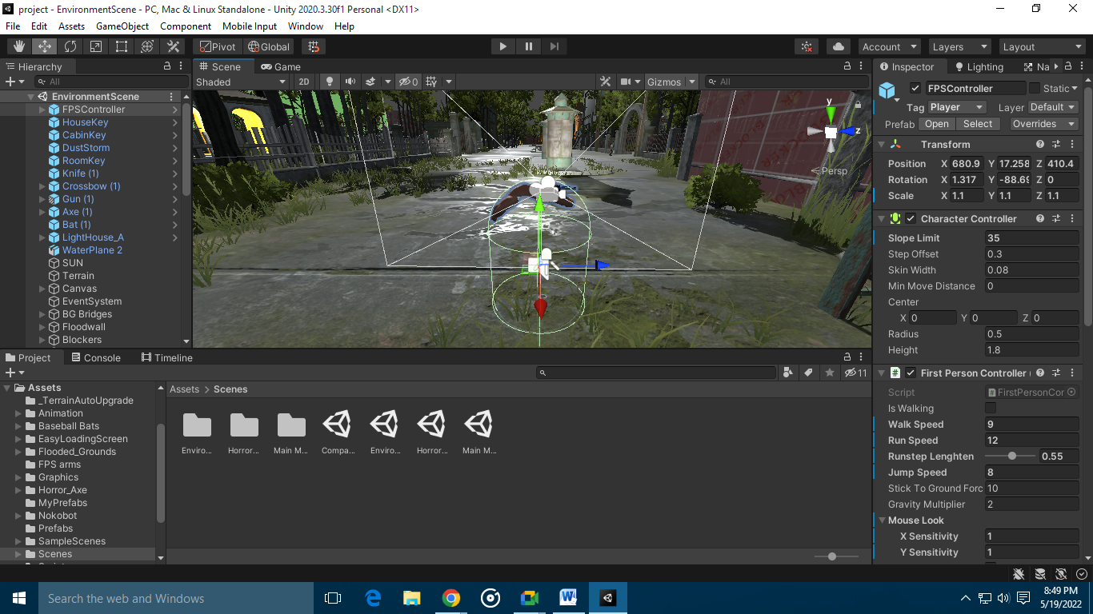
SCREEN SHOTS

Slide 22
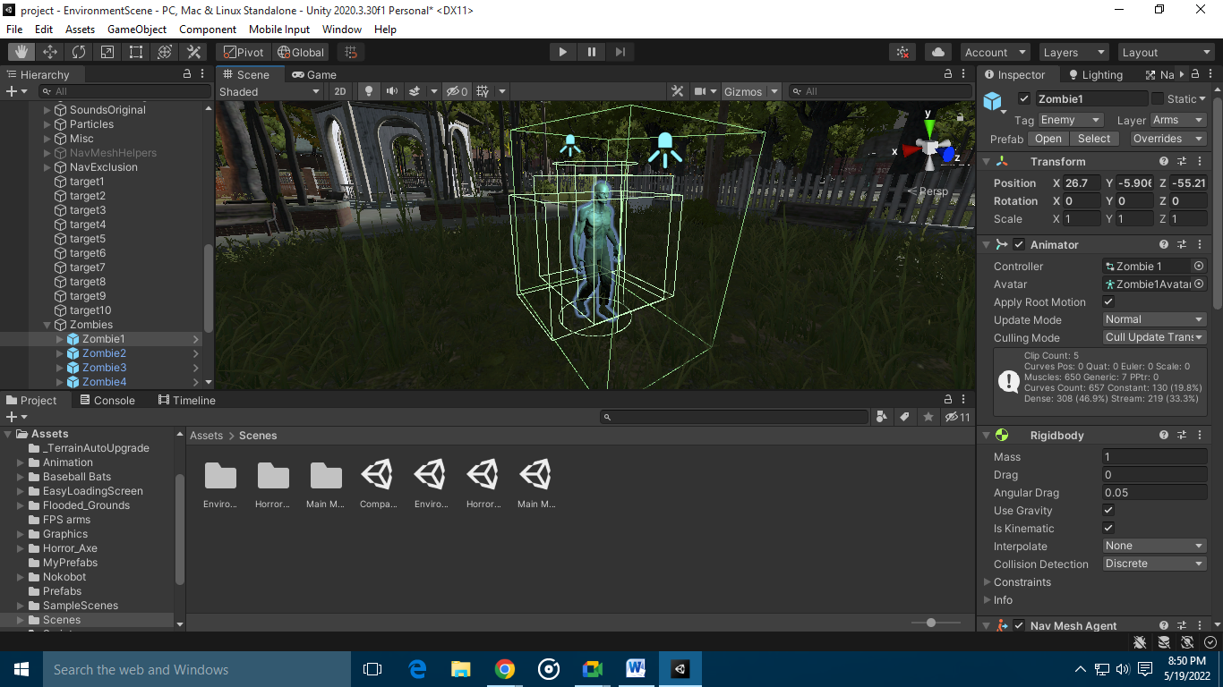

Slide 23
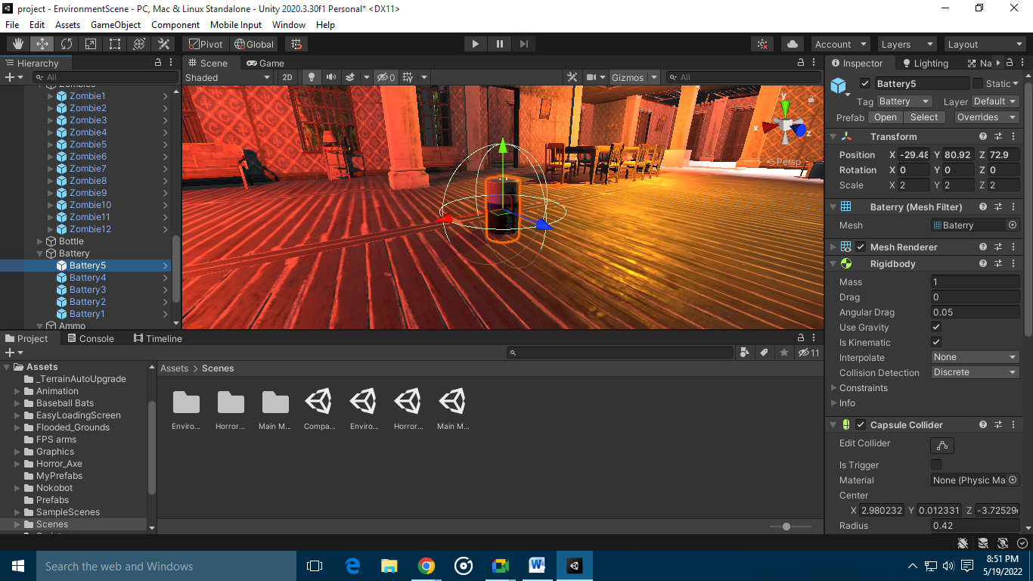

Slide 24
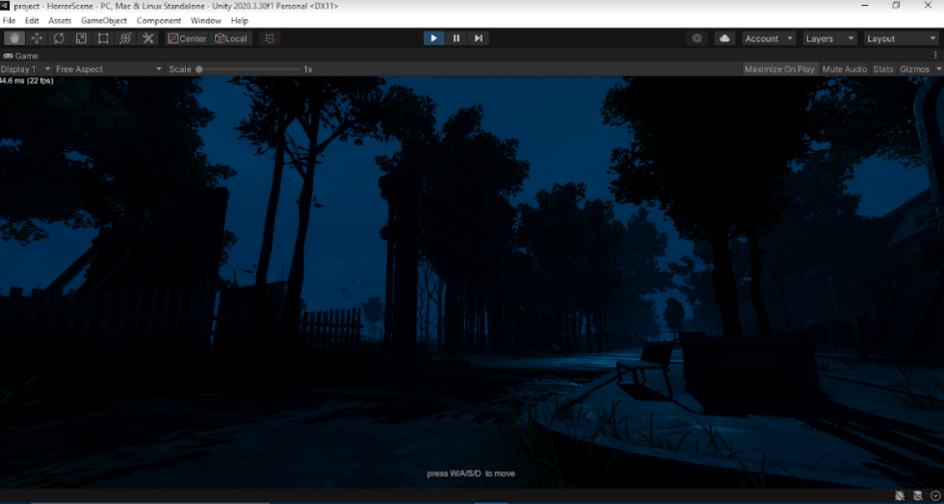

Slide 25
CONCLUSION
The aim of this project was to create a 3D game which was the First-Person Shooter game with Unity game engine. The most important aspect of our game design is to create more new playabilities. This game is a product of a beginner who favors creating a virtual world with his fundamental knowledge. There might be more possibilities for this game to be enhanced with more developed concepts in the future and there will be more updates to enhance the game play of the game.

Slide 26
REFERENCES
Rapid Skill Capture in a First-Person Shooter | IEEE Journals & Magazine | IEEE Xplore
Applying inexpensive AI techniques to computer games | IEEE Journals & Magazine | IEEE Xplore
Learning to win in a first-person shooter game | SpringerLink
Using Games to Study Law of Motions in Mind | IEEE Journals & Magazine | IEEE Xplore
Challenges and Opportunities in Game Artificial Intelligence Education Using Angry Birds | IEEE Journals & Magazine | IEEE Xplore

Slide 27
Lag Compensation for First-Person Shooter Games in Cloud Gaming | SpringerLink
Adaptive Shooting for Bots in First Person Shooter Games Using Reinforcement Learning | IEEE Journals & Magazine | IEEE Xplore
An implementation of affective adaptation in survival horror games | IEEE Conference Publication | IEEE Xplore
Optimizing Player and Viewer Amusement in Suspense Video Games | IEEE Journals & Magazine | IEEE Xplore

